Slide 1
VAST CHALLENGE
2018 MC 1
First Progress
Group Project by :
Batuhan Kir
Jun Yan Chen
Shravika Pinna
Chinmai Reddy Modugula
Kamal Afridi M S

Slide 2
Contributions
Initial understanding of Project and Datasets was studied and summarized collectively as a group.
Tableau work has been developed individually with equal contributions by collaborating through team meetings.
Batuhan Kir : Prepared Bubble plot for Overall Bird count, and Plotted Mitch’s Data points of all birds on map.
Jun Yan Chen : Illustrated birds path graph of all Birds before and after 2015, and path graph of blue pipits by each year.
Shravika : Plotted Dumping site of Kasios Firm’s waste, Kasios data points, and Plotted Data comparison maps of Mitch’s vs Kasios Data.
Chinmai : Made bar plot to find timely recording patterns and stacked plot of Blue Pipit count.
Kamal : Plotted Overall Growth rate of birds overtime, and created bar plot distinguishing the audio qualities of recorded sensor data.

Slide 3
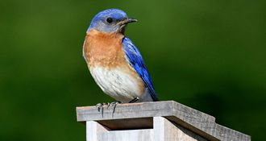
Project Overview
Mistford is a mid-size city located to the southwest of the Boonsong Lekagul Wildlife Preserve.
The city has a small industrial area with four light-manufacturing endeavors.
Mistford and the wildlife preserve are struggling with the possible endangerment of the Rose-Crested Blue Pipit, a locally loved bird.
The bird’s nesting pairs seem to have decreased alarmingly, prompting an investigation last year implicating Kasios Office Furniture, a Mistford manufacturing firm.
Since the initial investigation, the situation has evolved: Kasios insists that they have done nothing wrong!
They assert that grad student Mitch Vogel and his professors are mere media-seekers trying to draw attention away from their lackadaisical research.
Kasios presents itself as an extremely eco-friendly organization. They have launched their own very public investigation into the issues raised last year and are reporting very different results!

Slide 4
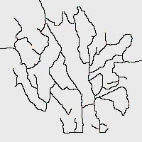
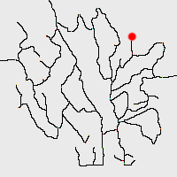
Overview of Lekagul Roadways Location
& Mapping Dumping site
“Lekagul Roadways 2018” is a 200 x 200 pixel map of the Preserve, with general indications of roadways through the site.
The alleged dumping site for the Kasios waste products was centered around coordinates (148,159).
To illustrate this Dumping site we used a website which helped us mark the location with coordinates.
Website Reference: https://www.mobilefish.com/services/record_mouse_coordinates/record_mouse_coordinates.php

Slide 5
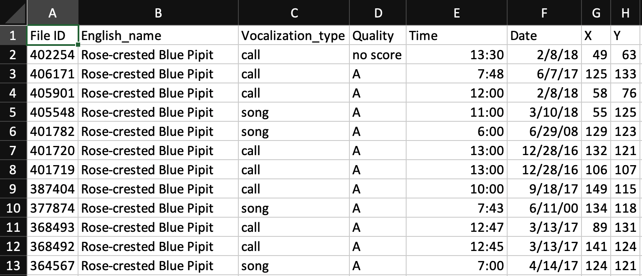
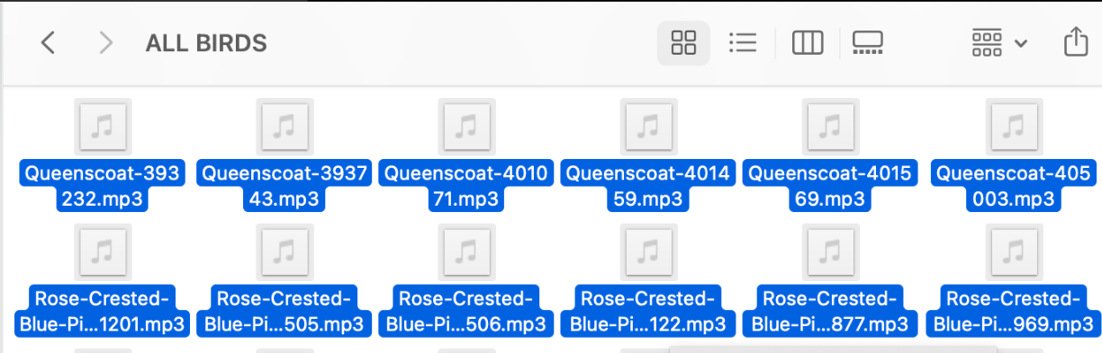
Mitch’s Dataset & Files
AllBirdsv4.csv
“AllBirdsv4.csv” is the metadata file for the bird sounds files.
This dataset containing the birdcalls collected by Mistford College.
The File ID is the index to the file names in the ALL BIRDS audio file collection.
The English_name is the common English name for the particular bird.
The Vocalization_type is the kind of bird sound.
Quality is a score of recorded audio A, B, C, D, or E.
Time and Date are for the capture of the sound.
Finally, X and Y are the coordinates on the enclosed map of where the sound was recorded.
All Birds Audio Folder

Slide 6
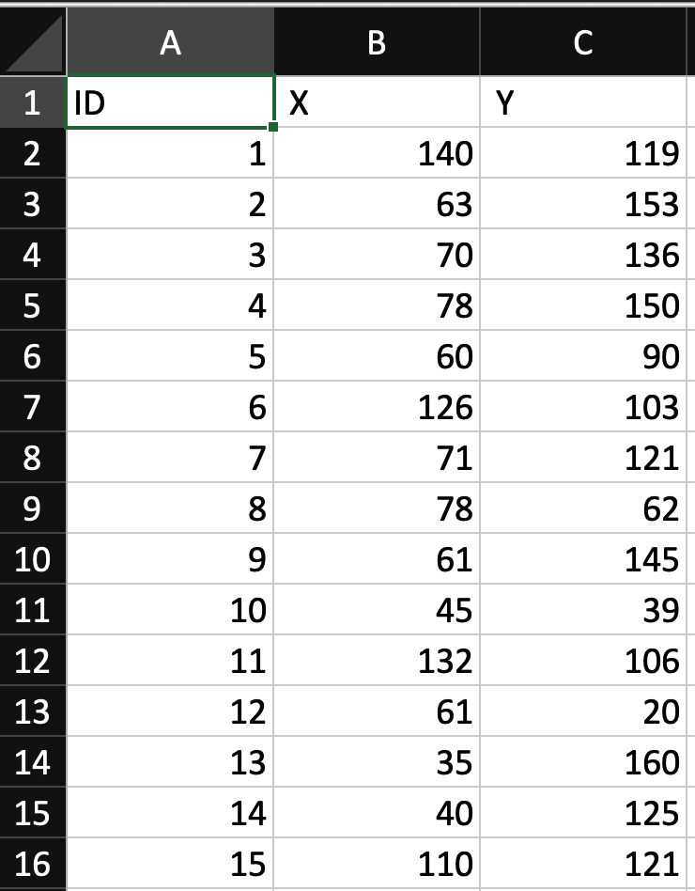
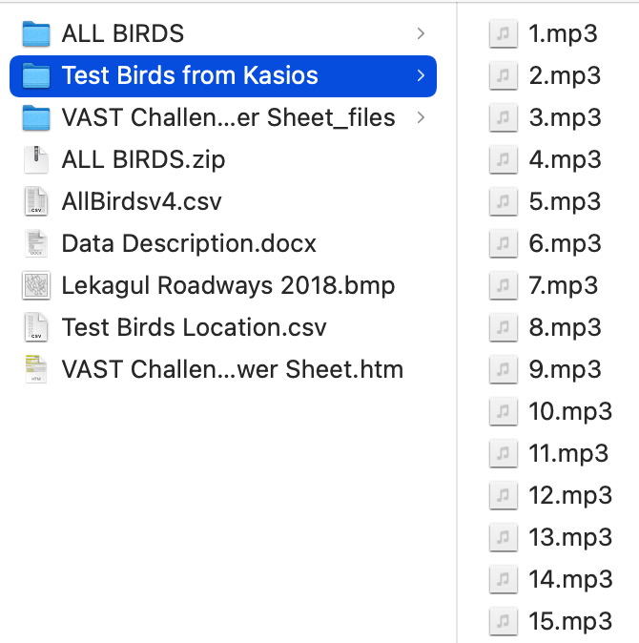
Kasios Dataset & Files
Test Bird Locations.csv | Test Birds Audio-Kasios Folder
“Test Birds from Kasios” are the bird sounds Kasios claims as Pipits from across the Preserve.
All of these recording were taken over the past couple of months.
“Test Bird Locations” indicate where in the pixel map the bird sounds were recorded.

Slide 7
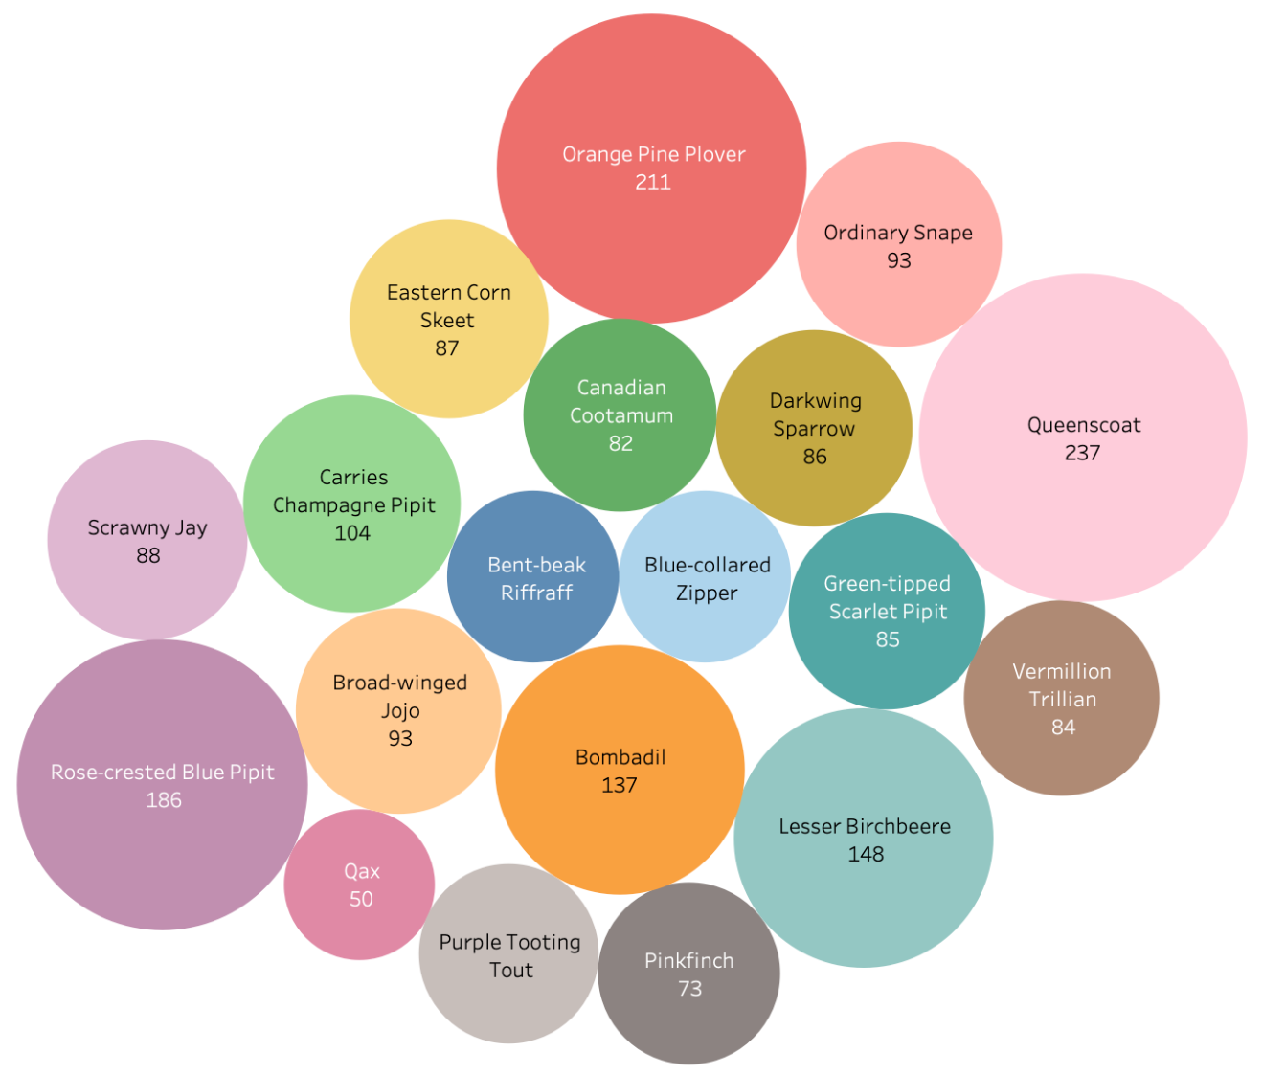
Visualising Overall Bird count by each species
Notes:
We can see blue pipits are one of the thriving population species of birds around this wildlife preserve.

Slide 8
Questions
Do we detect any trends or anomalies in the patterns?
Does Kasios set support the claim of Pipits being found across the Preserve?

Slide 9
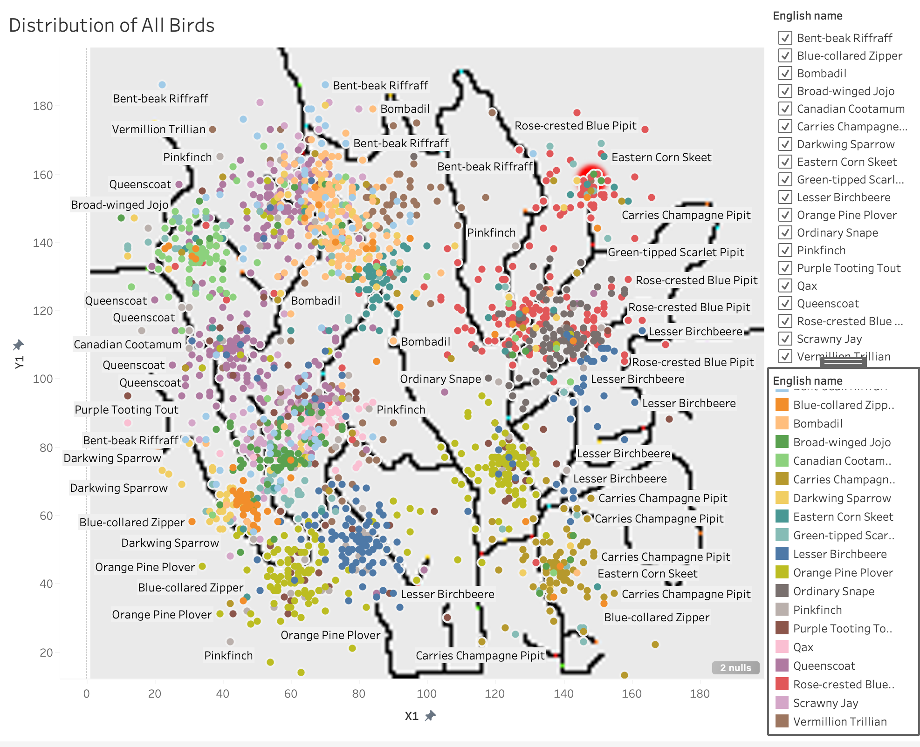
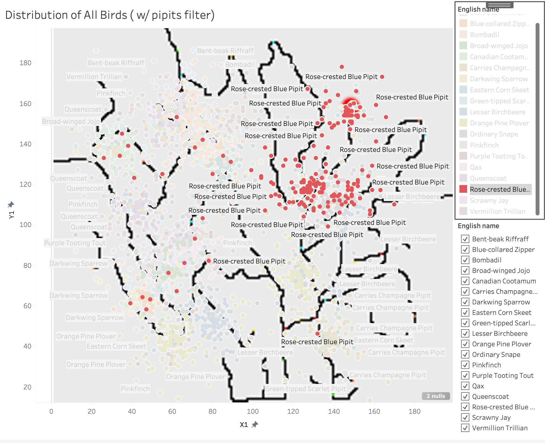
Mitch’s Data Distribution of All birds vs Blue pipits

Slide 10
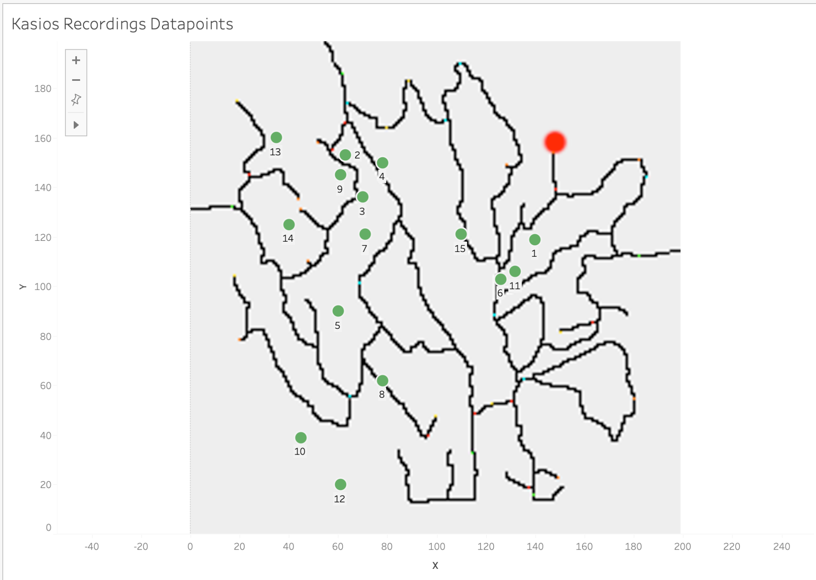
Kasios Data Distribution of Blue Pipits

Slide 11
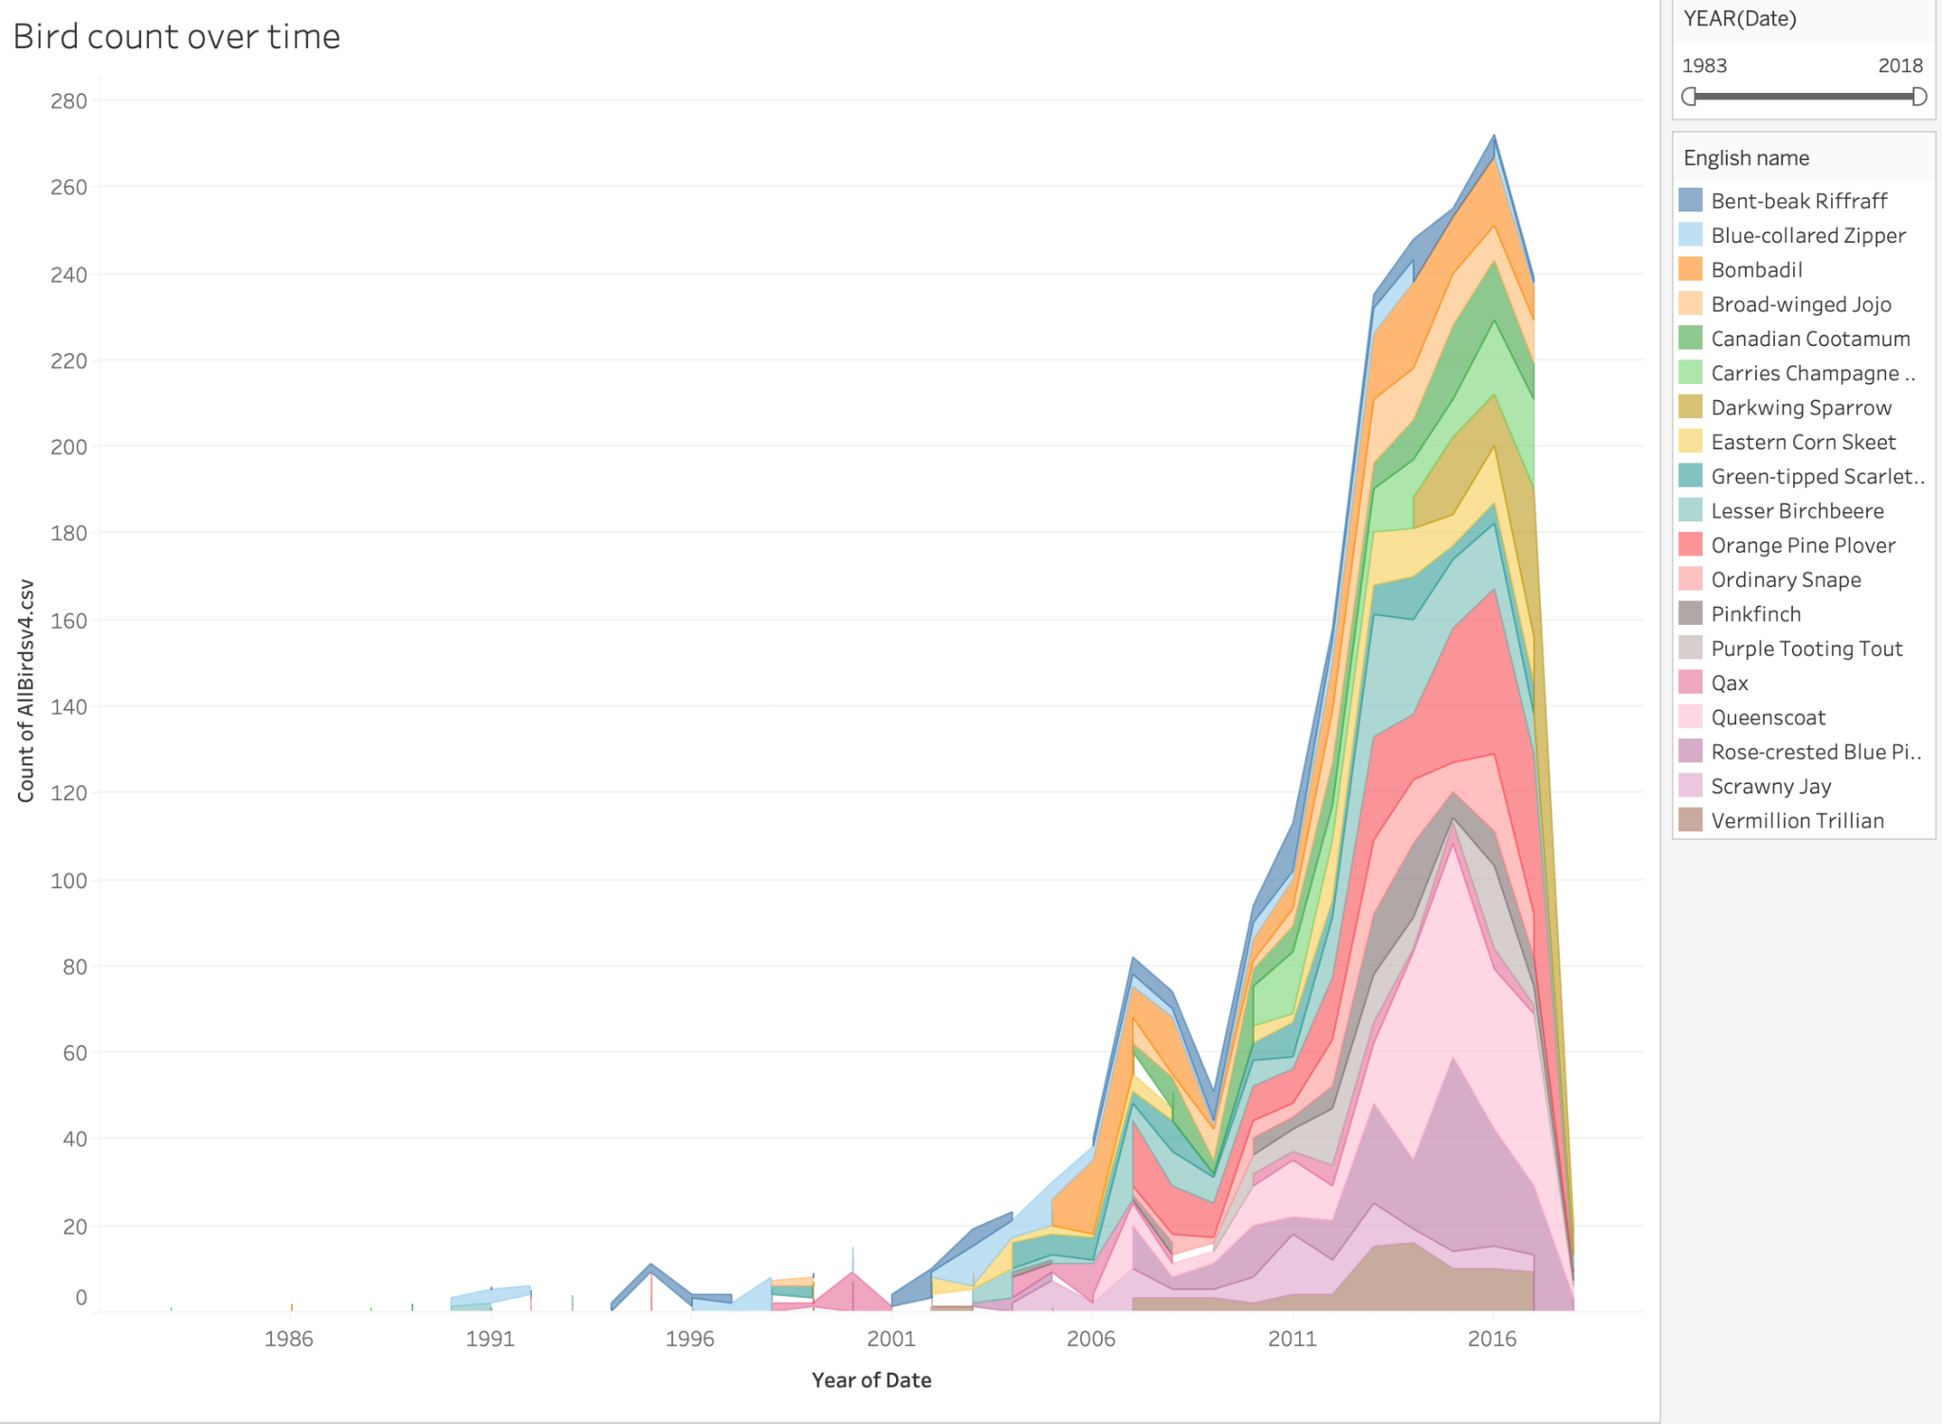
Pattern 1
Notes:
Data represents radical increase in count of birds from 2011 to 2016

Slide 12
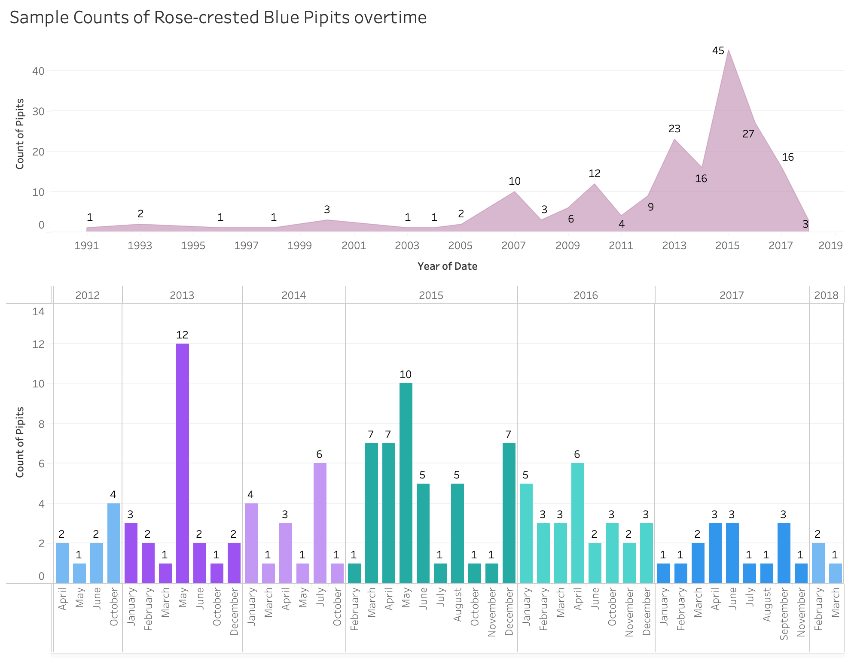
Pattern 2 :
Sample count of Blue Pipits Each Year / Each month
Notes:
After 2015 the overall count of blue pipits started decreasing gradually.

Slide 13
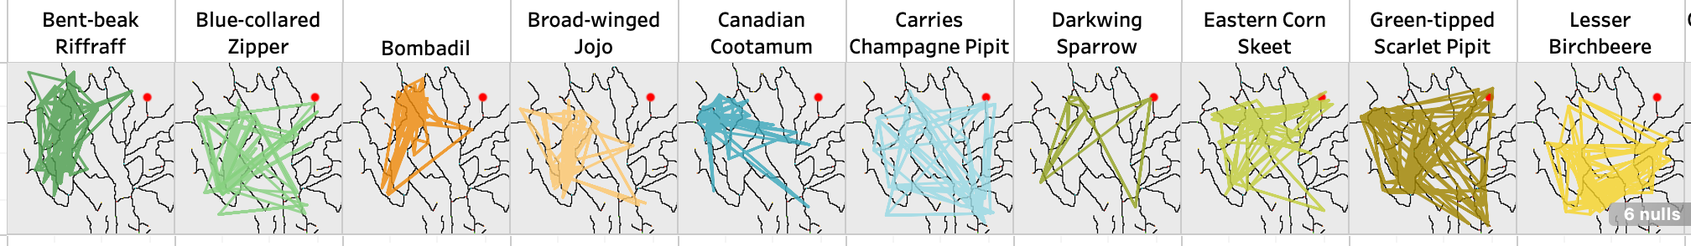
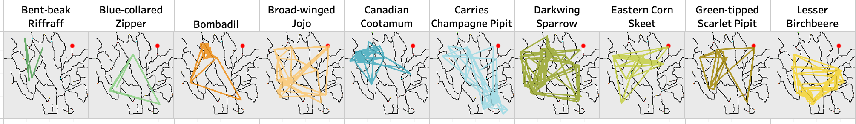
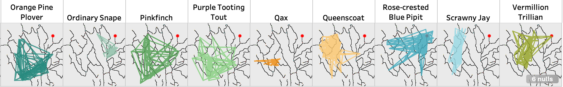
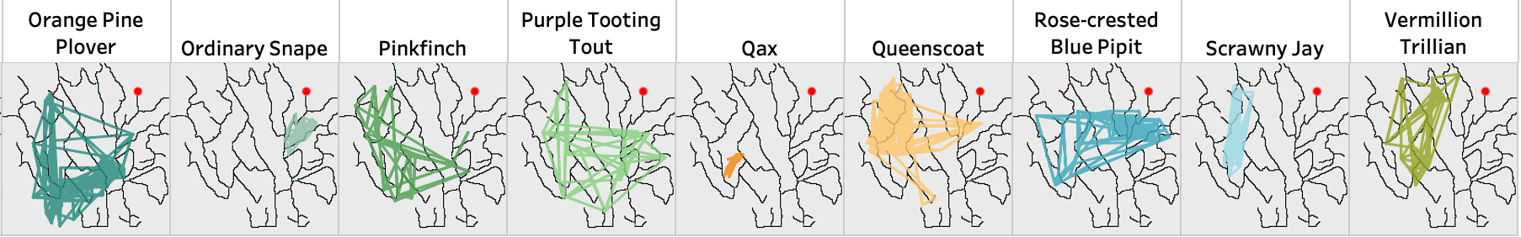
Path of All Birds before 2015 & After 2015

Slide 14
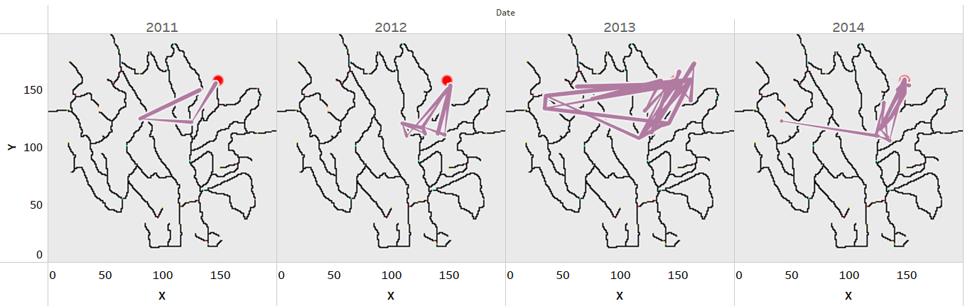
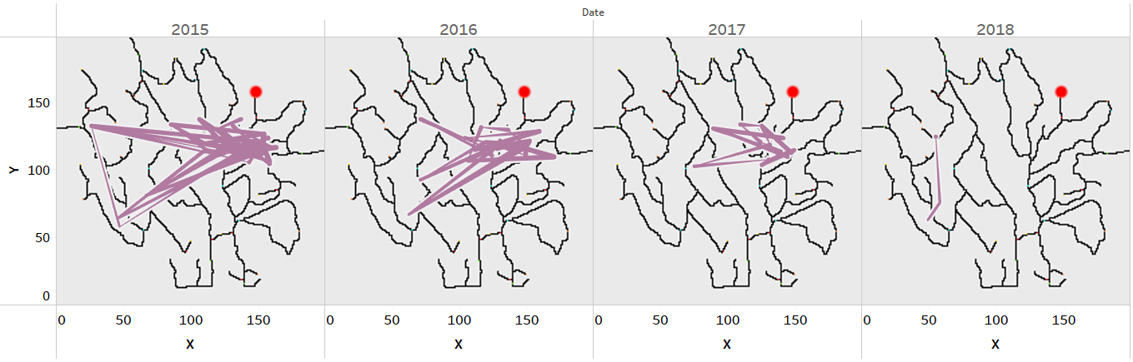
Pattern 3 : Path of Blue Pipits each year
Notes:
By this we can say path of Blue Pipits has substantially changed over the years indicating movement away from kasios dumping site.

Slide 15
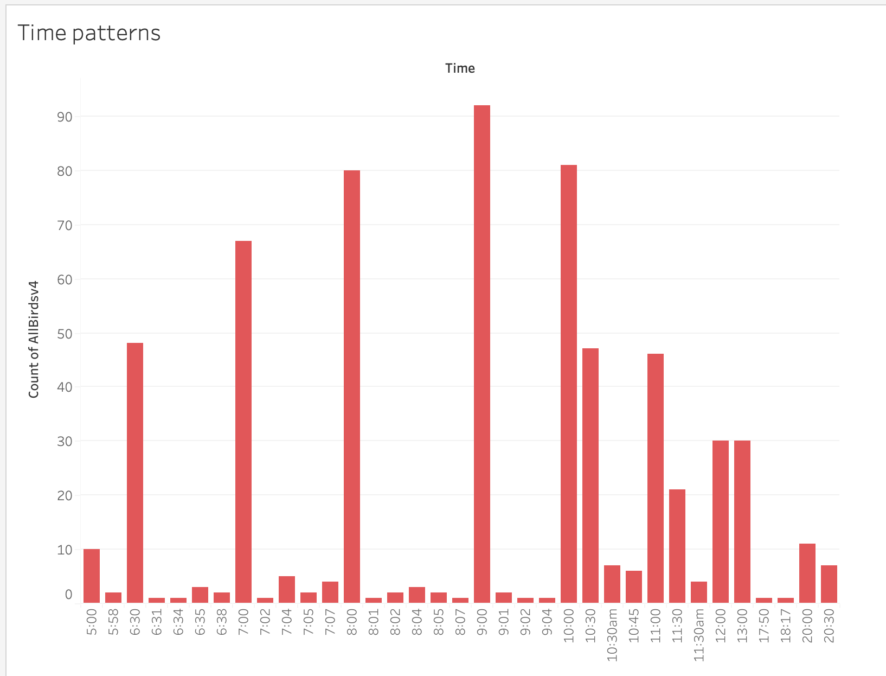
Pattern 4 : Recordings Time Pattern
Notes:
Most recordings have been recorded during times 10am to 12pm.

Slide 16
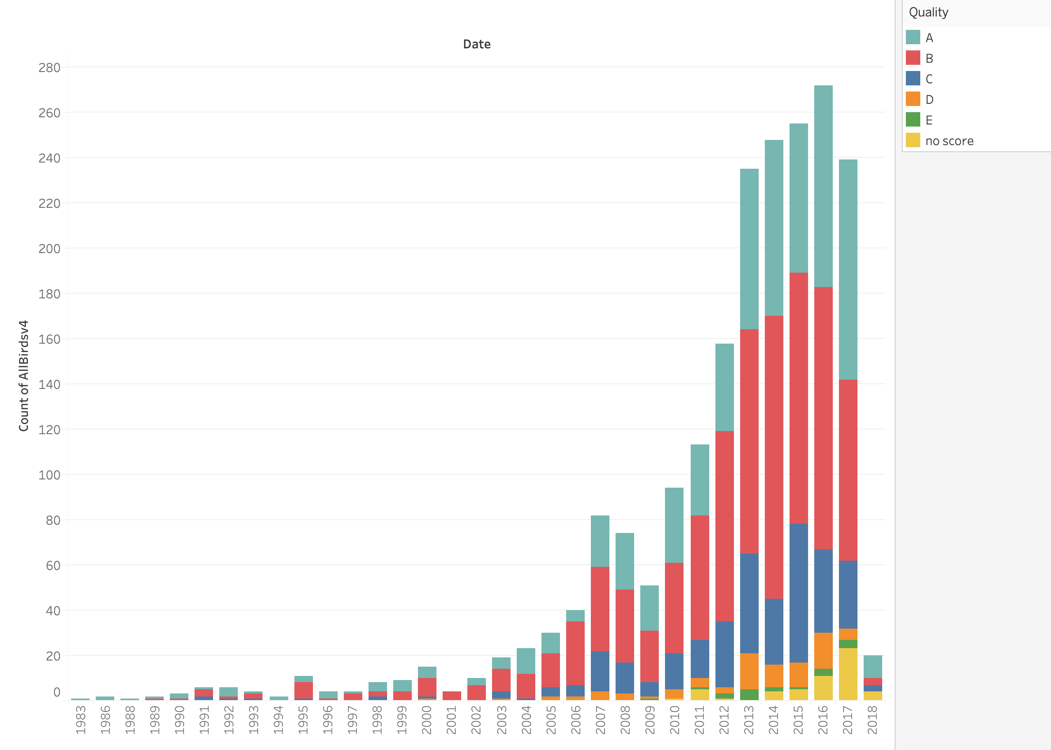
Pattern 5 : Recordings Quality Pattern
Notes:
By this pattern we can assume sensor quality has been decreased or birds are moving away from the sensor, we will be finding the reason using machine learning in progress 2.

Slide 17
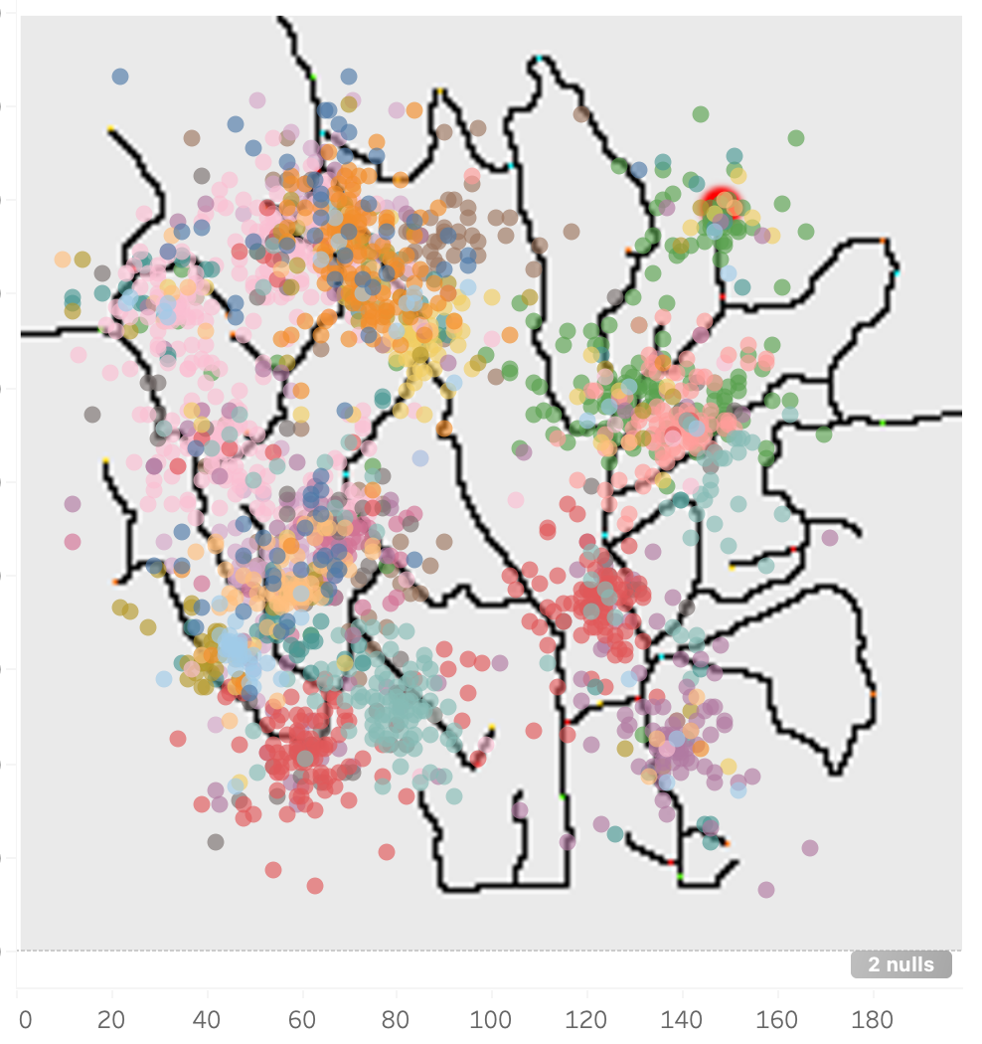
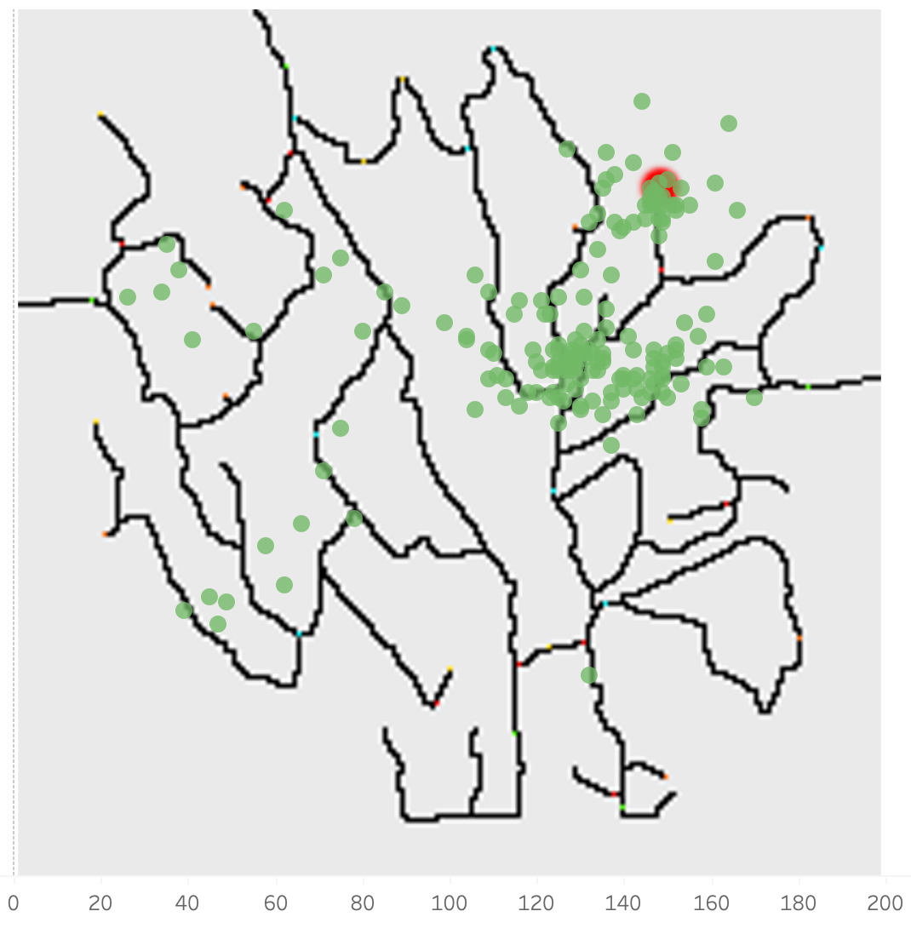
Q2.
Kasios vs Mitch Data
Patterns plotting Blue pipits
All Bird’s (Mitch’s Data)
Blue Pipit’s (Kasios Data)
Blue Pipits (Mitch’s Data)
Notes:
By comparing these 3 plots, we can assume these claims of Kasios about Blue Pipits being everywhere across the reserve looks like false claim, kasios might be misleading the investigation by showing us data of other birds instead of blue pipits.

Slide 18
Conclusion:
Our objective for the second progress report is to prove our assumption of false claims or agree with kasios.
For all the assumptions drawn, technical derivations will be shown using Machine Learning concepts and Python packages.

Slide 19
Thank You

